Slide 1
Foundations for a Healthier Built Environment
Date:
Presented to:
Presented by:

Slide 2
Foundations for a Healthier Built Environment
WORKSHOP PURPOSE
To build general awareness of the crossover between land use planning and community health
To build capacity to work more effectively with municipal and regional planners to promote better land use decisions
Notes:
Please credit for Tina Zenzola of “Safe and Healthy Communities Consulting” for most of the images and some of the slides in this presentation

Slide 3
Foundations for a Healthier Built Environment
WORKSHOP RATIONALE
Clear message from health professionals at a networking, collaborating forum held in October 2007
Increasing interest in Health and the Built Environment (HBE) given rise of chronic diseases whose causes can be clearly linked to and associated with land use decisions
Notes:
Please credit for Tina Zenzola of “Safe and Healthy Communities Consulting” for most of the images and some of the slides in this presentation

Slide 4
Foundations for a Healthier Built Environment
WORKSHOP AGENDA
Why?
Rationale for health professional involvement in land use planning
What/Who?
The planning process and the decision makers
How?
Tools and strategies
Notes:
Please credit for Tina Zenzola of “Safe and Healthy Communities Consulting” for most of the images and some of the slides in this presentation

Slide 5
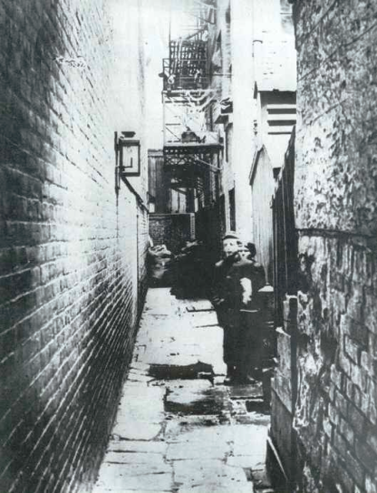
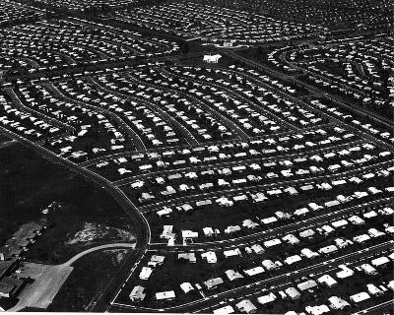
Urban Planning - Public Health: historical roots
Historically, public health and land use planning were closely allied
Disease prevention, sanitation, slum eradication
Segregation of land uses into specified geographic districts (Euclidian zoning)
Post-war - injury and disease prevention
Building permits and zoning for ventilation, exposure to toxic substances, development, and separating residences from industrial areas

Slide 6
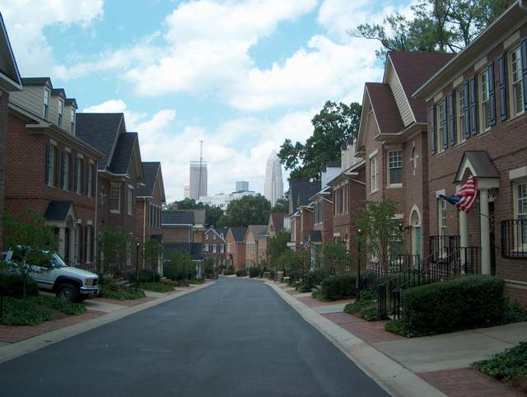
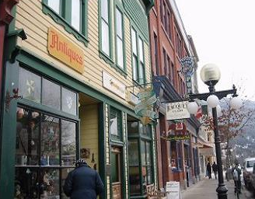
Current Planning Trends
Returning to “old fashioned” planning approaches
Emphasis on ‘community health and well-being’
Recognition of connections between development and quality of life
New Urbanism
Neo-traditional urban design movement
Smart Growth
‘Healthy Community’ land use principles

Slide 7
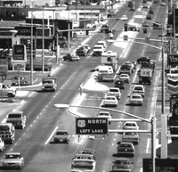
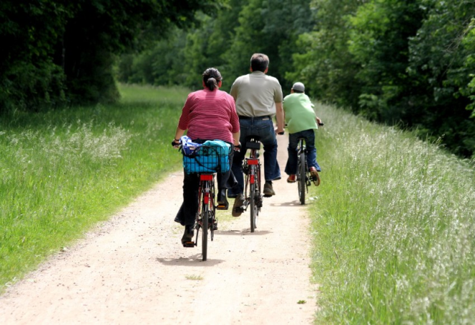
Defining the “built environment”
Built Environment
“The surroundings that we have created for our activities.”
Scale of surroundings vary
large-scale urban areas to rural development and personal space
Includes indoor and outdoor places

Slide 8
Many aspects of the built environment affect population health

Slide 9
Planning and investment policies
(regional and municipal
zoning and development rules)
“Ripple Effect”
Urban Form Patterns
(density mix, transport options,
access to parks and schools)
Individual Behaviour
(amount of walking, social isolation,
diet choices, recreation)
Population Health Impacts
(physical fitness, pollution exposure,
traffic crashes, social cohesion)
Adapted from Frank, Kavage, Litman (2006)

Slide 10
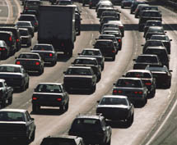
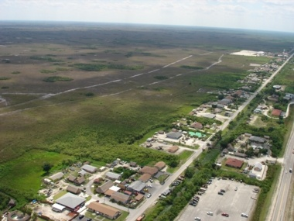
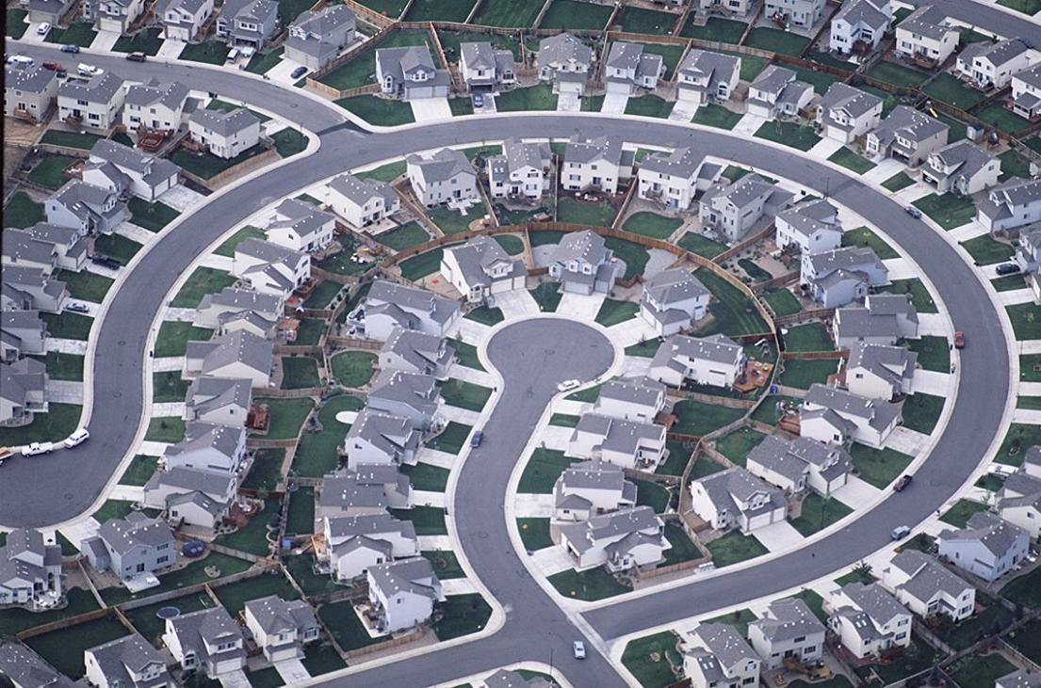
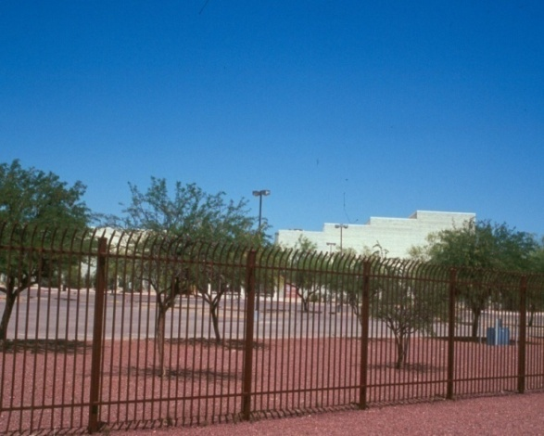
Asphalt nation
Rural sprawl
Urban sprawl
Environmental hazards
Schools on the fringe
Limited food security

Slide 11
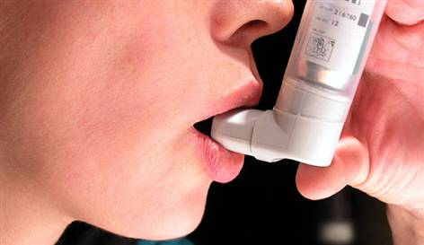
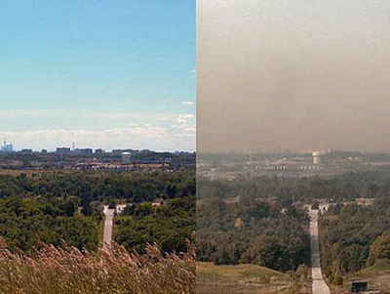
Impacts: air quality
Asthma is the most common chronic childhood disease
7% more asthma among kids living in neighbourhoods with high traffic pollution
2X risk of asthma symptoms in 5-7year olds living 250 feet or less from a major road
Leading cause of emergency room visits for children in Canada
Smog day, Toronto Source: Green Party of Canada

Slide 12
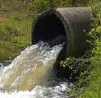
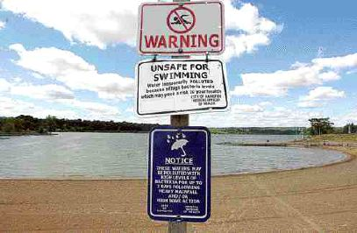
Impacts: water
Storm water runoff closes public beaches and harms environment
Water shortages limit recreational options, create impacts in natural areas and can limit other healthy activities (e.g., community gardens)

Slide 13
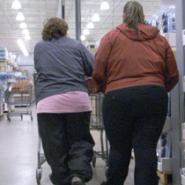
Impacts: children and youth
The rate of overweight Canadian kids has nearly tripled since 1981
National “inactivity level” in youth averages 58% in BC
Highly predictive – a “conveyor belt” to being overweight or obese as adults
1 in 3 will be diabetic
Average residents of pedestrian-friendly places weigh 7lb less than average resident in sprawling neighbourhood
Notes:
Kids also aren’t getting physical activity at school.
A 2006 study in Washington State found that the average resident of a pedestrian-friendly neighborhood weighs 7 pounds less than someone who lives in a sprawling neighborhood

Slide 14
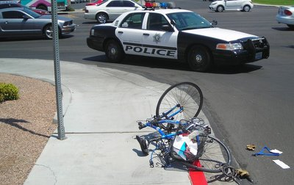
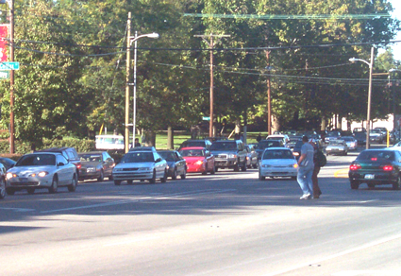
Impacts: injuries
Cyclist - pedestrian fatalities higher than driving
Seniors and school kids most vulnerable
Road design - wide arterials most dangerous
Traffic calming - reducing vehicle speed reduces risk of pedestrian injury

Slide 15
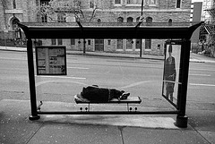
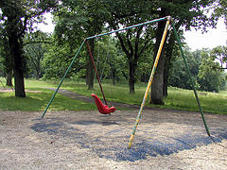
Impacts: mental health
Loneliness and isolation are toxic; social relationships are healthy
People with strong social networks:
Live longer;
Have less heart disease;
Are less depressed and use alcohol and drugs less;
Have fewer teen births;
Are healthier overall.
For every 10 minutes a person spends in a daily car commute, time spent in community activities falls by 10%
Notes:
Sightline Institute, WA (2006) - Studies have shown that for every 10 minutes a person spends in a daily car commute, time spent in community activities falls by 10%

Slide 16
Health promotion approaches that focus only on education about individual behaviour change have had limited success.

Slide 17
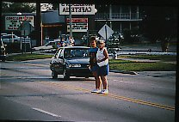
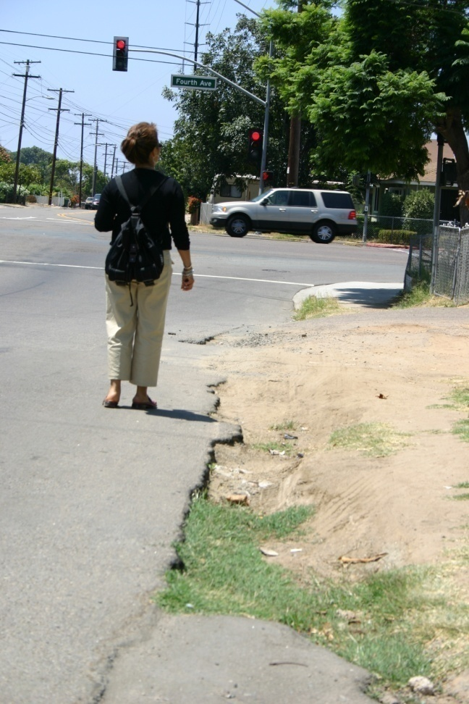
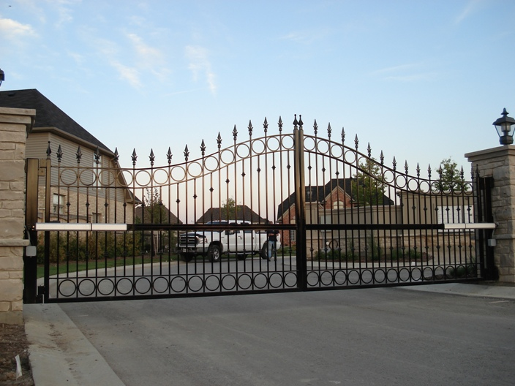
Is it just about behaviour change?

Slide 18
Tackling the connection between the Built Environment and Public Health
Policy changes at the local level can be most effective
Neighborhood environment one of the strongest predictors of physically active lifestyles
People want to live in places where they are able to be active
The economic benefits are also impressive
Notes:
So, if we can shift even a fraction of the short trips to walking/bicycling, it has the potential to have a greater impact on a larger portionn of the population than any other public health intervention.
But, community environment’s acting as a barrier to active living.

Slide 19
Rebuilding the connection between Urban Planning and Public Health
Built environment health care impacts threaten public health and universal health care system
Healthy lifestyle promotion is not enough -- the built environment must be addressed as well
Public health and planning share a responsibility to modify the built environment and promote active living
Notes:
19
So, if we can shift even a fraction of the short trips to walking/bicycling, it has the potential to have a greater impact on a larger portionn of the population than any other public health intervention.
But, community environment’s acting as a barrier to active living.

Slide 20
“Land-use decisions are just as much public health decisions as are decisions about food preparation. …We must measure the impact of environmental decisions on real people, and we must begin… to frame those decisions in light of the well being of children, not only in this country but across the globe.”
Richard Jackson
Director, National Center for Environmental Health
Centre for Disease Control (USA)

Slide 21
“Thus, a new role for public health leadership is emerging… in three principal areas of action. The 1st is to assess the health impact of land use and community design options…. The 2nd is to catalyze and facilitate inclusive partnerships with membership that stretches far beyond traditional health field…. 3rd, public health practitioners need to participate in policymaking on issues related to the built environment.”
MJ Aboelata
The Built Environment and Health
The Prevention Institute: Oakland CA, 2004
Notes:
Public health and urban planning need to make their relationship explicit again. Because of the strong impact of the built environment on health, Abaloeta (2004) recommends that public health practitioners should be involved in planning related to land use, zoning and community design.

