Slide 1
Building organizational capacity for health equity action
Presenter
Date
Location

Slide 2
Objectives
Review how health equity and social determinants relate to EPHP practice
Explore ways to increase capacity for health equity action at the EPHP and organizational levels

Slide 3
Agenda
Introduction
Review of health equity and the social determinants of health in environmental public health practice
Capacity for health equity action in environmental public health organizations
Q&A
Scenario review
World Café
Conclusion and next steps

Slide 4
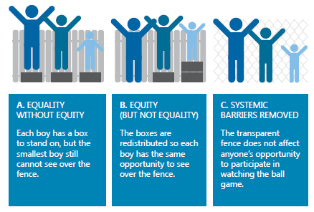
Health equity
When everyone has a fair opportunity to reach their full health potential without disadvantages caused by their social, economic, or environmental circumstances.
(NCCDH)
EPHPs can promote health by supporting individuals and by removing barriers.
Notes:
This summary slide can replace slides 12-14.

Slide 5
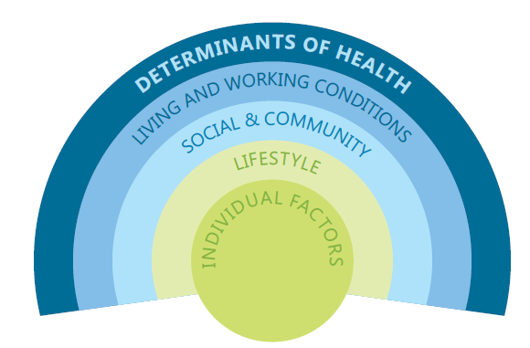
Social determinants of health (SDH)
Inequities in SDH….
May be associated with undue exposure to unhealthy environments.
Affect individuals’ actions in ways that affect their exposure and health status.
Can increase vulnerability to environmental factors that negatively impact health and wellbeing.
May be associated with decreased access to services that could address the impacts of unhealthy environmental exposures.
http://nccdh.ca/resources/glossary/
Notes:
Patterns in the distribution of the SDH create inequities in the health of populations and communities.
This can create barriers to compliance with public health regulations, as well as impact people’s ability to live healthy lifestyles.
Therefore, it is important to address SDH if we want to achieve health for all people.

Slide 6
Equity and EPH practice
SES
Food premises
SDWS
Culture & Language
Food premises
PSEs
Literacy & Education
SDWS
Food premises
PSEs
Psycho-social
Geography
Housing
Food premises
SDWS
Food premises
Built environ.
Housing
Built environ.
Notes:
This slide shows the social determinants that frequently arise in different settings of environmental public health practice.
Socioeconomic status
Financial restrictions/cash flow - ability to pay for maintenance or upgrades
Employee finances in job security - working when sick because of income or job security issues
Cultural differences
Expectations of EPHPs/operator relationship
Immigrants in new industry (food)
Language/Literacy - comprehension of regulations and requirements
Limited English language skills
Low literacy/computer literacy
Stress
Distraction
Intensify other barriers
Housing issues such as bed bugs or mould often relate to social determinants of health
Geography
Access to equipment, parts, expertise
Food security in remote communities - use of meat and foods from non-approved sources in aboriginal or remote communities with limited access to alternatives

Slide 7


What is an “equity lens”?
“The window is determined by the frames we use to look through. We need a new frame.”
“Life changes the lens you look through.”
Shutterstock.com
Openclipart.org
- Ryan Meili @ St FX - March 2, 2016
- Sean O’Toole, CIPHI - NS
Source: NCCDH
Notes:
When we talk about considering health equity in environmental public health practice, we consider applying an “equity lens.” This refers to the way we think about what we do and the people we work with.
There can be targeted programs to address health inequities and minimize gaps related to the social determinants of health. It may seem simple, but applying an equity lens can impact practice too.
This slide courtesy of NCCDH.

Slide 8
Systems approaches in public health
Notes:
In this section, we will explore how systems approaches can help apply an equity lens in environmental public health practice.

Slide 9
Systems thinking
“[a] perspective that considers connections among different components, plans for the implications of their interaction, and requires transdisciplinary thinking as well as active engagement of those who have a stake in the outcome to govern the course of change”
(Leischow & Milstein 2006)
Notes:
Public health is based on the awareness that health is affected by more than individual biology and behaviour (Midgley 2006) (e.g., John Snow + pump + cholera).
As we have learned, health behaviours (e.g., ability to comply with health regulations) is affected by circumstances that originate outside the immediate context.
Systems thinking helps to put all the pieces together – What determines health and how can different sectors play a role?
Citation: Leischow SJ, Milstein B. Systems Thinking and Modeling for Public Health Practice. American Journal of Public Health. 2006;96(3):403-405. doi:10.2105/AJPH.2005.082842.

Slide 10
Determinants of health
Structural
Intermediary
Income
Education
Occupation
Social class
Gender
Race/ethnicity
Material circumstances
  housing, neighborhood quality, consumption potential, physical work environment
Psychosocial circumstances
  stressors, living circumstances and relationships, social support & coping styles
Behavioural and/or biological factors
  nutrition, physical activity, tobacco & alcohol consumption, genetic factors
World Health Organization (WHO) conceptual framework.
Solar and Irwin, 2010.
Notes:
We have been exploring the social determinants of health and how they influence practice.
We can break that thinking down further to consider the structural and intermediary determinants of health. This can help articulate how SDH operate as underlying factors and shows how EPH practitioners can take action on the social aspects of health.
Structural determinants refer specifically to the interplay between the socio-economic and political contexts -- structural mechanisms that generate social stratification and the resulting socio-economic position of individuals. These are what we mean when we talk about the social determinants of health inequities. And these are the most upstream factors that are changed at a policy level and affect society broadly.
Intermediary determinants are further down the stream than the structural determinants, depending on which intermediary determinant we are talking about.
material – consumption potential is the financial means to buy healthy food, warm clothing, etc…
psychosocial – focus is on the impact of social environment and mental health impact
behavioural & biological – lifestyle based, individual focused – really downstream
This slide courtesy of NCCDH.
Citation: A conceptual framework for action on the social determinants of health. Discussion Paper Series on Social Determinants of Health, no.2
http://www.who.int/social_determinants/publications/9789241500852/en/

Slide 11
Health impact pyramid
Health choices are impacted by factors beyond individuals’ control (Frieden 2010)
Most PH impact = least individual action
  Education
  Clinical intervention
  Long term intervention
  Default decision context
  Socio-economic determinants of health
EFFORT
IMPACT
Notes:
Bottom tiers – context and determinants of health – are the most impactful on population health.
The goal is to “change the environmental context to make healthy options the default choice, regardless of education, income, service provision, or other societal factors.”
Behaviour-based health promotion is politically popular. Changing the context (ie determinants of health) is difficult and often controversial, but can be more effective.
e.g.:
Ensuring everyone has the same opportunity for education, regardless of social circumstances.
Making fresh foods affordable and available everywhere.
Citation: Frieden TR. A Framework for Public Health Action: The Health Impact Pyramid. American Journal of Public Health. 2010;100(4):590-595. doi:10.2105/AJPH.2009.185652.

Slide 12
Healthy public policy
Policy that improves health by
addressing social, economic, and environmental
determinants of health
www.ncchpp.ca
Notes:
Healthy public policy improves health by acting on the broad determinants of health
Policies that influence health can come from non-health agencies
e.g., community economic development might promote cottage industry food processing
influences health from SDH perspective + food security
also raises food safety risks
Therefore cross-sector communication and collaboration are very important.

Slide 13

Public health practice is changing
Shift focus from individuals to structures & systems
Make healthy choices easy choices
Address root causes
SDH & health equity
Photo: Karen Rideout
Notes:
So what does all this mean for public health practice?
Public health renewal in many provinces is resulting in new kinds of events, interventions, etc. that EPHPs and others may be responsible for.
Ontario Public Health Standards and Health Equity Guideline
BC Guiding Framework for Public Health
NS Heath Equity Protocol
e.g. Bed bugs, healthy built environment, food security, equity, determinants of health, etc.

Slide 14

EPH role is changing
Judicious use of enforcement to
consider the big picture
Less reliance on enforcement and more support for healthy practices
Scaling up from local practice to policy?
Photo: Karen Rideout
Notes:
Many things don’t fit well into traditional inspection models
e.g., small food processing operation in isolated area may not be equipped to meet standards designed for industrial scale operations
Keeping the stick but using it less – using open communication as health promoting tool to increase compliance and decrease need to use enforcement tools.
Many individual practitioners or regions have adopted responses for different kinds of situations, but varies from place to place. Need to scale up and share these best practices.
Are broad provincial PH goals reflected in your training/job description?
Are you supported by management?

Slide 15
Ways to integrate an equity lens into eph practice
Notes:
This section examines different approaches to start putting equity in programs and policies at an operational level.

Slide 16
Re-imagining “environment”
Social
Built
Natural
Air
Water
Land
Soil
Houses & buildings
Transportation
Public space
Noise
Infrastructure
Socioeconomic
Cultural
SDH
Connectedness
Power & inequity
Barnett and Casper, 2001 http://www.ncbi.nlm.nih.gov/pmc/articles/PMC1446600/pdf/11249033.pdf
Notes:
If your are questioning how or whether health equity fits into an environmental public health mandate, consider how you define “environment.”
Environment is not just air, water, soil, or even built environment. It includes the communities in which we live and the social circumstances of the people who live in those communities.
A lens of equity and SDH is an opportunity for EPHPs to take a leadership role and be innovative in your approach to creating and supporting healthy environments for the whole population.

Slide 17
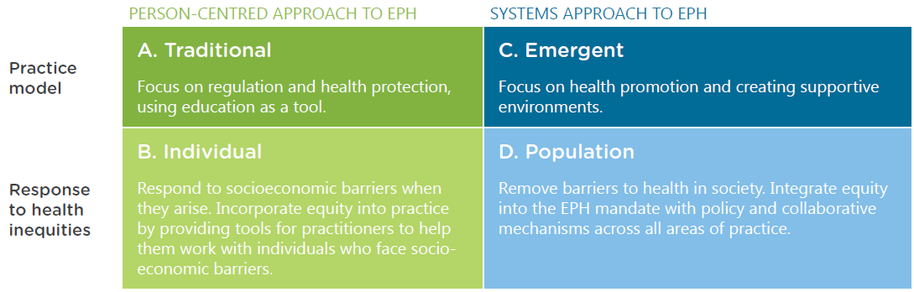
Moving toward equity-oriented EH practice
Notes:
The BCCDC Through an Equity Lens project viewed environmental public health practice in terms this framework. Most people probably practice in more than one of these quadrants, and change depending on the situation.
EPH can respond to or address inequities within any of these four approaches to practice.
PERSON-CENTRED = Compassion – Doing things better with a focus on people.
SYSTEMS-APPROACH = Avoiding unintended consequences and narrowing the equity gap – Doing better things.
Can be doing both person-centred and population-centred work. Probably both are needed at the beginning, and person-centred are more immediate responses.
--CLICK FOR ANIMATION—
However, the goal is to move toward population- and systems-based approaches for broader impact. (Recall the Health Impact Pyramid.)

Slide 18
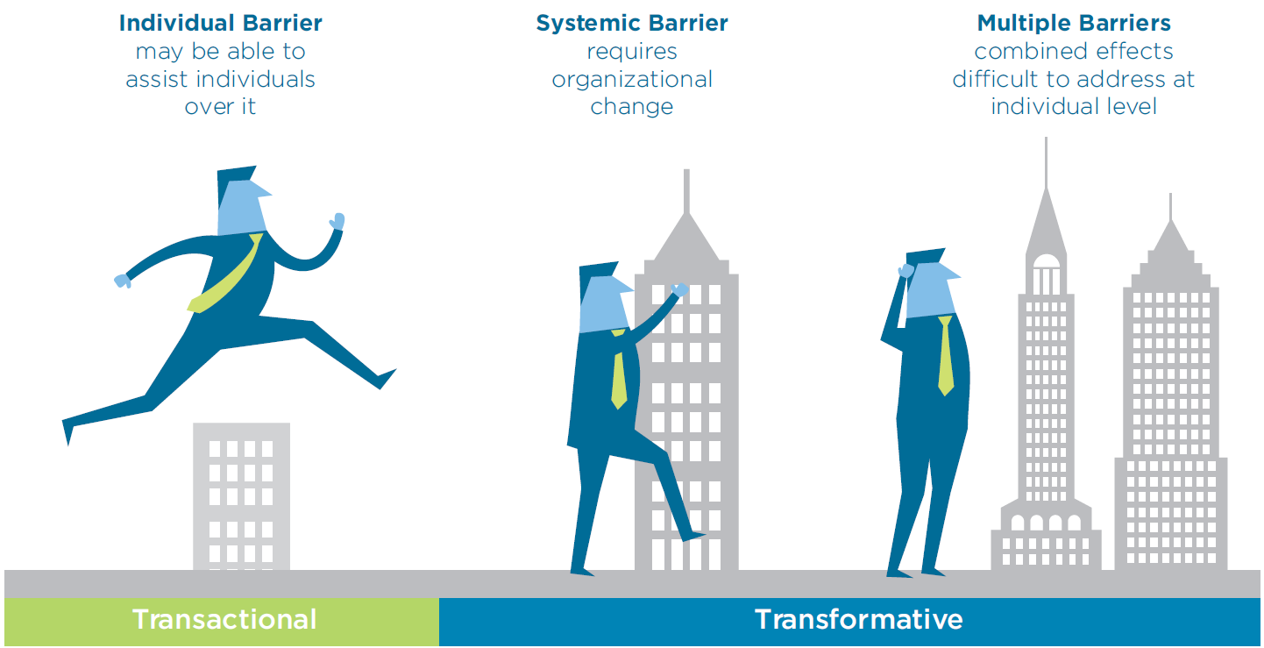
Responding to inequities
Notes:
This graphic illustrates these approaches in a slightly different way.
INDIVIDUAL/TRANSACTIONAL: Deal one on one and try to help the person. This will not reduce the inequity gap, but is a shorter term fix (e.g. having a translator to aid with inspection).
SYSTEMIC: Change the system to make it more equitable (e.g. reduce gaps in distribution of the social determinants of health). Takes longer, but impacts more people over a longer term.
MULTIPLE: Change the system, and also help individuals deal with their unique circumstances (e.g. reduce gaps in distribution of the SDH, but also increase access to services for specific populations with different needs).

Slide 19

Capacity to advance health equity in EHP
Individuals
Time
Knowledge
Organizations
Mandate
Executive champions
Skills
Discretionary authority
Tools
Role clarity
Manager buy-in
Organizational culture &
strategic direction
Intra-/Inter-agency collaboration & communication
Reporting structure & job descriptions
Appropriate/flexible legislation
http://www.bccdc.ca/health-professionals/professional-resources/health-equity-environmental-health
Notes:
These are some factors that can support the implementation

Slide 20
Facilitators and barriers
 | Facilitators | Barriers
Individual | Discretionary powers Values/principles/shared vision of health promotion Strong personal networks Capacity (training and experience) | Knowledge gaps Tension between health promotion and enforcement Lack of guidance
Systemic | Legislative power and policy Organizational support/leadership Organizational structure Intra-and inter-agency collaboration External partnerships Equity tools and strategies Training/capacity building Communication | Incomplete, unclear, or inflexible legislation Policy process Lack of resources
http://www.bccdc.ca/resource-gallery/Documents/Educational%20Materials/EH/BCCDC_facilitators-to-equity_web.pdf
Notes:
A BCCDC report called “Equity-integrated environmental health practice: Facilitators and barriers” highlights success stories and identifying facilitators and barriers to integrating equity in practice.
Organizational or job-related issues can:
directly impact EPHPs’ ability to respond to equity-related barriers, or
make it difficult for them to take on what might be seen as an added level of responsibility on top of their core job duties.
High workload, lack of resources, and high staff turnover were stated as making it difficult for EPHPs to give extra time and attention to situations that face SDH related barriers.
Sometimes individual EPHPs figure out how to approach different situations through their own experience. Then with staff transition, when they move on and new staff come in, there is no opportunity to share that knowledge, so the new person starts from scratch and has to learn it themselves instead of benefitting from what their predecessor figured out.
Prescriptive policies on how to implement certain regulatory actions and lack of management support to do things differently make it difficult for EPHPs to take context and individual factors into account.
Where environmental health is situated into public health overall can be fragmented, making it difficult for staff to collaborate across departments.

Slide 21

Apply an equity lens to your mandate
Build capacity
Recognize complexity
Foster collaboration and leadership
Integrate to evaluation and reporting
http://www.bccdc.ca/resource-gallery/Documents/Educational%20Materials/EH/Five%20strategies%20for%20organizational%20change%20on%20equity.pdf
Notes:
This short document distills down various facilitators and barriers to integrating equity into EPH practice.
It is designed for managers and directors to get started thinking about these issues and provide ideas for how to start taking action.
Short and to the point.

Slide 22

Equity 101-4: What Health Protection can do to support health equity
BCCDC | https://youtu.be/ZIHEZ5wUs2g
Notes:
This 6-minute video from BCCDC identifies organizational facilitators and barriers to show how health authorities can integrate health equity lens to environmental health.
https://www.youtube.com/watch?time_continue=1&v=ZIHEZ5wUs2g

Slide 23
Policy levers
Legislation varies widely
  compliance measures often prescriptive
Organizational culture/strategic priorities
  often focused on health care delivery
  can support equity approach
Leadership and executive champions
http://www.bccdc.ca/resource-gallery/Documents/Educational%20Materials/EH/Equity%20in%20EH%20Policy%20Levers.pdf
Notes:
Another BCCDC report called “Environmental scan of policy levers for equity-integrated environmental public health practice in BC” examines how to use existing legislation, policy, and frameworks/strategic plans to integrate an equity lens in practice.
Use policy to clarify and work with mandate issues. You can find a way – there are examples from across Canada in the report.

Slide 24

Clear vision
Collaborate
Regulatory flexibility
Equity champions
EH mandate
http://www.bccdc.ca/resource-gallery/Documents/Educational%20Materials/EH/BCCDC_policy-levers_web.pdf
Notes:
This short document is a summary of the policy levers report – aimed at managers, directors, etc.
Addresses some of the concerns about restrictive mandate and how “soft” skills of HE fit into a regulatory profession.
Balance inspection requirements with health promotion efforts.

Slide 25
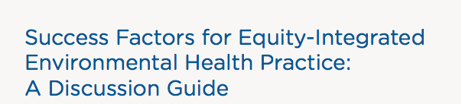

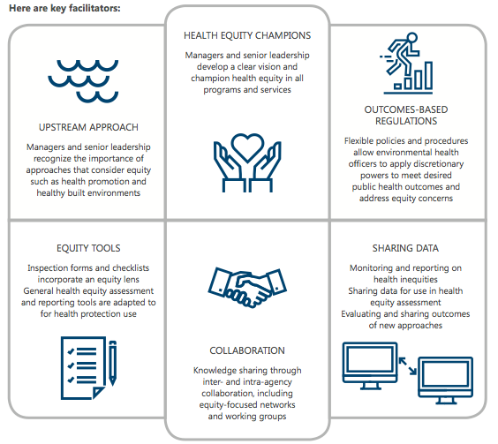
Notes:
Use this discussion guide in team meetings, retreats and group planning, etc. Could also be used individually.
Short case study examples.
Highlights the critical success factors that applied.
3 discussion questions to apply to issues in own context.
http://www.bccdc.ca/resource-gallery/Documents/Educational%20Materials/EH/Equity%20in%20EPH%20success%20factors%20discussion%20guide.pdf

Slide 26

Framing concepts:
Environ. justice
HPP
Health in All Policies
Healthy Communities
OneHealth
Implementation tools:
HIA
GIS
Community participation
Public health champions
http://www.bccdc.ca/resource-gallery/Documents/Educational%20Materials/EH/Equity%20conceptual%20frameworks%20_rev.pdf
Notes:
Presents some bigger picture concepts that might be useful for strategic planning.
Brings in some more concrete tools and suggests which areas of practice they might fit.
HIA – to identify and predict unintended consequences
GIS – data to identify inequities and vulnerable populations
Community participation – find out the real issues, barriers, and service needs
Champions – Make things happen in organizations

Slide 27
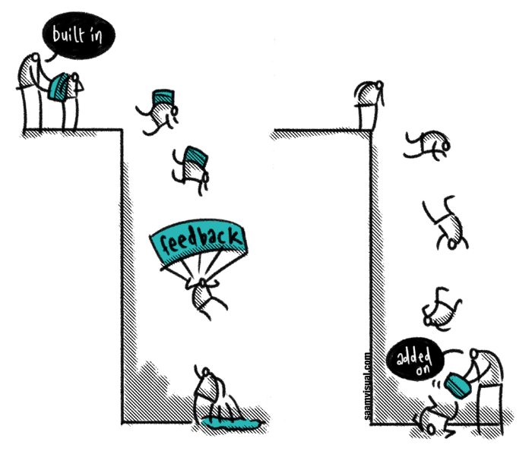
“Build it in” …not “add it on”
https://reflectingenglish.wordpress.com/2014/11/22/feedback-built-in-or-added-on/ | Image: @jasonramasami
Notes:
Given mandates and workload, it is important to point out that using an equity lens is not about giving up inspection and enforcement OR adding yet another thing to EPHPs’ busy schedules.
There are ways to build it in to what you already do.
In theory, real action to address inequities in the SDH will decrease the inspection/enforcement load because it is a preventive model. It should make things easier for folks who are having difficulty, decreasing the time EPHPs spend re-educating people or dealing with repeat or highly complex calls.
Over time, this can be tracked and evaluated.

Slide 28
Moving toward an equity lens
Measure
Capacity
Collaborate
Clarify
Performance measures
Time mgmt.
Data re vulnerable pops
Org. structures
Upstream approaches
Internal
Cross-sector
Evaluation
Roles
Notes:
This slide suggests how to proceed from here with incorporating health equity and the SDH into EPH practice.
This partly involves skill-building and training for EPHPs, but changes are needed at the management, public health organization (e.g., health authority, health unit, public health department), and government levels to facilitate EPHP action.
EPHPs use a lot of ad hoc strategies – explaining things by demonstration instead of just verbally to get past language barriers.
In focus groups, they talked about the need for translation services and multilingual resources. One of the ad hoc things they reported using here was drawing on a teenager or other friend or family member to translate the health protection information into the language that the parents (who were the operators) would understand.
EPHPs have reported leaning on each other a lot.
They do not have access to other practitioners for collaboration .
Formal structures to encourage and support intersectoral collaboration would help address some underlying equity-related issues.
Guidance on discretion would help them feel they had authority to be flexible and make judgements, so they can respond to the situation based on the context of other things happening that might be having an impact, like personal poverty of the operators preventing their business’ ability to meet regulations.
EPHPs will benefit from specific training and education on how SDH and health equity impact health. Risk communication and risk-based inspection training was suggested as helping them know how to explain the importance of meeting the regulations as they impact the operator’s personal well being as well.
See http://www.ncceh.ca/content/creating-space-enabling-organizational-capacity-action-health-equity for more information.

Slide 29

Scenario review
Notes:
Use this slide for a collective exercise that gets people out of their seats.
Participants independently review short scenarios posted around the room. Scenarios are designed to illustrate the kinds of health equity issues that arise in environmental public health, as well as to encourage self-reflection and provoke new ways of thinking about these issues.
Participants will be asked to walk around the room and read the scenarios. They are presented as examples of how EPH and health equity have come together to give a sense of some of what we have learned about promising practices and ways that EPH staff can be involved with the social determinants of health and health equity.
Consider these scenarios and your own individual reflections as you enter the rest of the session.
NOTE:
Scenarios are available in the Ready-Made Session folder where you downloaded this PPT presentation.
This exercise is an optional component in the Introduction to Health Equity session, so participants may have already seen these scenarios. If participants have already done this exercise, consider one of these options instead:
Post or share print-outs of the scenarios for a brief review and provide a few minutes to reflect on the questions on the next slide.
Omit this exercise and provide a few minutes for participants to reflect on how health equity has been or could be addressed within their program or health authority. Invite them to think of where they might already be impacting health equity and how they could leverage those efforts to be a little more impactful.

Slide 30
Health equity scenarios
What is the main issue raised in this scenario (i.e. the obvious problem)?
What underlying issues might be present
(i.e. the not-so-obvious problem)?
How would you typically approach the situation?
Can you think of alternative approaches?
How might the outcomes differ between the two approaches? What are the arguments for and against using each approach?
Notes:
Use this slide to guide group discussion about the health equity scenario exercise (walkabout or small group discussion format).

Slide 31
World café instructions
Discuss the question on your table
Make notes & pictures on the table
Think of ideas, be creative
Be open to new possibilities –
imagine there are no practical challenges
Change tables at the bell –
you will discuss 3 of 5 questions

Slide 32
World Café table hosts
Record ideas throughout the conversation. Summarize in the plenary.
Remind people to note or share key ideas, insights, connections, and new questions to contribute to the final report.
At the beginning of each round of conversation, briefly share key ideas from the prior conversation so others can link and build using ideas from their previous conversations.

Slide 33
World Café principles
FOCUS on what matters
CONTRIBUTE your thinking
SPEAK your mind
LISTEN to understand
LINK AND CONNECT ideas
LISTEN for insights and patterns
PLAY, DOODLE, DRAW
NO LIMITS!
Notes:
Don’t get caught up in what is feasible. At this stage we just want to generate ideas and suggestions for how to do things.
No need to get bogged down in what might work or not at this.

Slide 34
World Café discussion questions
What opportunities in your health region might be leveraged toward action on HE and SDH?
How might EPHPs be recognized for time spent working from a HE/SDH perspective?
What training would facilitate application of an equity lens in practice?
How could HE and SDH be worked into CIPHI competencies?
What kind of management support or policy would help implement an equity lens in practice?
Notes:
Each question is on two tables. We will discuss for 15 minutes, and then people will switch tables – go to a table with a different colour sheet. I will ask the table hosts to stay put and provide continuity into the next group’s discussion.
Change the questions to suit your needs.
What opportunities in your health region might be leveraged toward action on health equity and social determinants of health?
Are there other public health professionals are involved with the social determinants of health and health equity?
Are there other professionals outside of public health that are involved with these issues?
Are there any standards, policies, tools, or strategic plans that highlight the importance of health equity to the public health mandate? (e.g., equity protocols, public health standards, health equity impact assessment tools, healthy communities frameworks, etc.)
How might EPHPs be recognized for time spent working from a health equity & social determinants of health perspective?
If an individual EPHP is interested in doing this work, how can they make it happen?
Are there opportunities for EPHPs to be involved in organizational activities to support this? (e.g., performance appraisal, continuous quality improvement, program planning)
Can individual efforts be shared/highlighted in staff meetings, internal newsletters, etc.?
What training would facilitate the application of an equity lens in practice and/or involvement with community coalitions?
Are there professional development opportunities being offered to other public health staff that would support EPHPs?
Where can you look to learn more about the social determinants of health and health equity?
Could health equity be introduced in staff meetings or training sessions?
How might a role for EPHPs be more clearly stated?
How could health equity and the social determinants of health be worked into CIPHI competencies or Board of Certification requirements for environmental public health practice?
Are there opportunities to influence the education and training of EPHPs?
Can social determinants of health be incorporated into student placements?
How can training standards incorporate health equity so that institutions and educators are more likely to address these issues?
What kind of management support or regional/provincial policy would help implement an equity lens in environmental public health practice?
What would make it possible for your health region/health unit to support EPHPs to work on social determinants of health and health equity?
How might managers or supervisors in your organization champion this work? What about executives?
What is needed from the provincial level to support this work? From the Ministry of Health?

Slide 35
Summary and next steps
Notes:
Optional:
Summarize the main points you wish to highlight for the group.

Slide 36

This Photo by Unknown Author is licensed under CC BY-NC
Notes:
Questions

Slide 37



Contact & Acknowledgements
Through an Equity Lens
BC Centre for Disease Control
pph@phsa.ca
http://www.bccdc.ca/health-professionals/professional-resources/health-equity-environmental-health
Notes:
Remind everyone to fill out evaluation forms.

