Slide 1
Health equity knowledge to action for EPHPs
Presenter
Date
Location

Slide 2
Objectives
Review how health equity and social determinants relate to EPHP practice
Illustrate how individual EPHPs can take action
Learn about health equity tools available
Generate ideas about possible actions and ways to overcome barriers to action

Slide 3
Agenda
Introduction
Review of health equity and the social determinants of health in environmental public health practice
Equity 101 Video 5 – What EPHPs can do to
Health equity tools for environmental public health practice
Framework – exercise
We all have a role to play – exercise
Conclusion and next steps
Evaluation

Slide 4
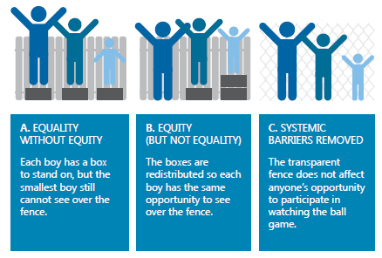
Health equity
When everyone has a fair opportunity to reach their full health potential without disadvantages caused by their social, economic, or environmental circumstances.
(NCCDH)
EPHPs can promote health by supporting individuals and by removing barriers.
Notes:
This summary slide can replace slides 12-14.

Slide 5
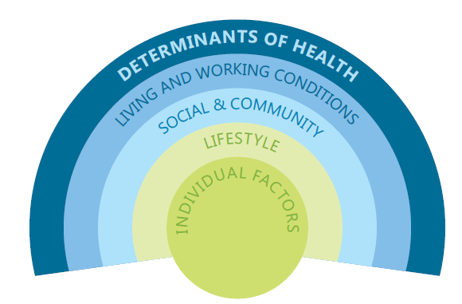
Social determinants of health (SDH)
Inequities in SDH….
May be associated with undue exposure to unhealthy environments.
Affect individuals’ actions in ways that affect their exposure and health status.
Can increase vulnerability to environmental factors that negatively impact health and wellbeing.
May be associated with decreased access to services that could address the impacts of unhealthy environmental exposures.
http://nccdh.ca/resources/glossary/
Notes:
Patterns in the distribution of the SDH create inequities in the health of populations and communities.
This can create barriers to compliance with public health regulations, as well as impact people’s ability to live healthy lifestyles.
Therefore, it is important to address SDH if we want to achieve health for all people.
NOTES:
Discuss how SDH can create health inequities. Facilitator may wish to have brief check-in with participants to ensure understanding of these concepts.

Slide 6

Equity 101-5: What EHOs can do to support health equity
BCCDC | https://youtu.be/UX48Ns-ccWY
Notes:
This 5.75-minute video from BCCDC identifies concrete actions that individual EPHPs can take to support health equity through their practice.
https://www.youtube.com/watch?v=UX48Ns-ccWY

Slide 7
Equity and EPH practice
SES
Food premises
SDWS
Culture & Language
Food premises
PSEs
Literacy & Education
SDWS
Food premises
PSEs
Psycho-social
Geography
Housing
Food premises
SDWS
Food premises
Built environ.
Housing
Built environ.
Notes:
This slide shows the social determinants that frequently arise in different settings of environmental public health practice.
Socioeconomic status
Financial restrictions/cash flow - ability to pay for maintenance or upgrades
Employee finances in job security - working when sick because of income or job security issues
Cultural differences
Expectations of EPHPs/operator relationship
Immigrants in new industry (food)
Language/Literacy - comprehension of regulations and requirements
Limited English language skills
Low literacy/computer literacy
Stress
Distraction
Intensify other barriers
Housing issues such as bed bugs or mould often relate to social determinants of health
Geography
Access to equipment, parts, expertise
Food security in remote communities - use of meat and foods from non-approved sources in aboriginal or remote communities with limited access to alternatives

Slide 8


What is an “equity lens”?
“The window is determined by the frames we use to look through. We need a new frame.”
“Life changes the lens you look through.”
Shutterstock.com
Openclipart.org
- Ryan Meili @ St FX - March 2, 2016
- Sean O’Toole, CIPHI - NS
Source: NCCDH
Notes:
When we talk about considering health equity in environmental public health practice, we consider applying an “equity lens.” This refers to the way we think about what we do and the people we work with.
There can be targeted programs to address health inequities and minimize gaps related to the social determinants of health. It may seem simple, but applying an equity lens can impact practice too.
This slide courtesy of NCCDH.

Slide 9
Tools and resources
Notes:
This section provides an overview and introduction to some tools and resources available to environmental public health staff to help incorporate an equity lens to practice.

Slide 10

Framework for EPH action
10 considerations for action
Enhance knowledge
Apply concepts to practice
Reflective practice
Identify internal and external collaborators
Approaches at multiple organizational levels
http://www.ncceh.ca/documents/guide/toward-health-equity-practical-actions-public-health-inspectors
Notes:
Originally developed as a thought piece for individuals, but pilot testing suggested that it would also have value as a tool to guide staff meetings or strategic planning exercises.
This was produced jointly by BCCDC, NCCEH, and NCCDH.

Slide 11

Framework for EPH action
User Guide
3 main audiences:
Frontline EPHP
Managers & directors
Educational & professional development organizations
http://www.ncceh.ca/documents/guide/toward-health-equity-practical-actions-public-health-inspectors
Notes:
There is a User Guide to accompany the framework.
It includes ideas for how and when to use the Framework in different setting such as staff meetings.
NOTE: If doing the Framework Exercise, note that you will revisit this later in the session and give participants a chance to try it out.

Slide 12


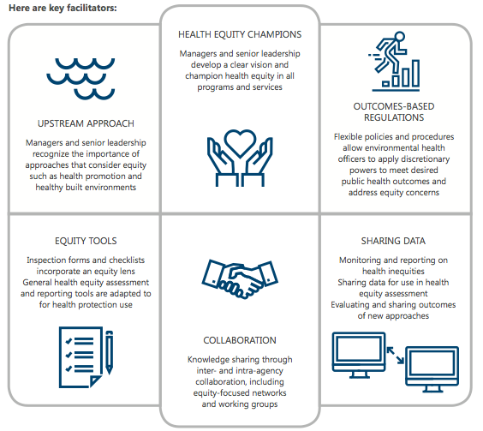
Notes:
Use this discussion guide in team meetings, retreats and group planning, etc. Could also be used individually.
Short case study examples.
Highlights the critical success factors that applied.
3 discussion questions to apply to issues in own context.
http://www.bccdc.ca/resource-gallery/Documents/Educational%20Materials/EH/Equity%20in%20EPH%20success%20factors%20discussion%20guide.pdf

Slide 13
Equity 101 videos
Introduction to health equity for EPH professionals
Introduction to the social determinants of health for EPH professionals
How the social determinants of health impact EPH practice settings
What Health Protection can do to support health equity
What EPHPs can do to support health equity
http://www.bccdc.ca/health-professionals/professional-resources/health-equity-videos
Notes:
Equity 101 is a series of five animated videos for EPHPs and Health Protection leaders. Each 5 to 7-minute video addresses a specific aspect of health equity in relation to environmental health practice.
Video 1 introduces the concept of health equity and how it relates to EPHP practice.
Video 2 introduces the social determinants of health, with examples of how they impact practice.
Video 3 shows how social determinants arise across different EPHP practice settings.
Video 4 identifies organizational facilitators and barriers to show how health authorities can integrate health equity lens to environmental health.
Video 5 identifies concrete actions that individual EPHPs can take to support health equity through their practice.
Each video builds on the information presented in earlier videos. Although designed to be watched as a series, they can be viewed individually.

Slide 14
2-1-1 referrals
EPHPs witness a wide range of equity-related issues that fall outside scope of practice
  Incidental observations
  Complaint calls outside EPH mandate
Often no mechanism for action or follow-up
Some referral or response on ad hoc basis
Notes:
Referral and collaboration have repeatedly come up as important success factors to addressing health equity needs.
Housing calls or complaints are a major challenge in areas that do not have a clear EPH mandate for housing. (Note that Alberta EPHPs have a Housing Regulation).
The lack of mechanisms for EPHPs to do referral and collaboration frequently arise when discussing challenges.
In response, BCCDC initiated a partnership with an organization called bc211 to facilitate EPHP referrals to other services that might help clients with complex problems.
2-1-1 services are available in many provinces and territories.

Slide 15

bc211 training
Government, health, and NGO services
Province-wide coverage
Updated regularly
Trained intake professionals
Targeted EPHP training
Non-profit
Confidential
Telephone, text, website
www.bc211.ca
Notes:
bc211 is a non-profit organization that provides confidential information and referral to community, government, and social services via telephone, text message, and a website.
The phone lines are operated by trained “information and referral specialists” who are skilled at asking the right questions to identify underlying issues and direct people to the most appropriate available services.
NOTE: Toolkit users outside BC are advised to update this slide with local information. Visit http://211.ca/ to learn more.

Slide 16
bc211 training process
EPHPs trained re how/when to contact bc211
  EPHP will call, text, or web chat to bc211 on behalf of client
  EPHP will give bc211 number or website to client
bc211 updating key terms and services most relevant to EPH
EPHPs asked to track and report use of bc211 for evaluation and service improvements
www.bccdc.ca/health-professionals/education-development/bc211-training
Notes:
Training for EPHPs begins in fall 2018. In some health authorities, EPHPs will receive training from bc211. In others, managers or senior staff will be trained so they can provide information about bc211 services directly to their staff.
2-1-1 services are available to anyone, for use whenever issues arise that are outside scope of practice, or where there seem to be underlying issues that are resulting in repeated or complex calls to Health Protection.
NOTE: As of August 2018, BCCDC is exploring the possibility of videotaping a bc211 training session. Contact pph@bccdc.ca for updates and to inquire about accessing the video, which may be applicable for EPHPs using 2-1-1 services in any region.

Slide 17


Health equity assessment
Tool to assess a program, policy, or organization with a health equity lens
Notes:
There are many tools available to do health equity assessments. Find one that works best for your needs.
ON Ministry of Health and Long-Term Care: Health Equity impact Assessment - http://www.health.gov.on.ca/en/pro/programs/heia/
Fraser Health: Health Equity Assessment Tool – Workbook and Handbook
University of Victoria Equity Lens in Public Health project: Health Equity Tools Inventory - https://www.uvic.ca/research/projects/elph/index.php

Slide 18

Framework reflection
Review the Framework
Choose one of the action points (2–9)
Answer the questions as best as you can
Consider how you could find out more
Identify one action you can take right away
Notes:
Use this slide for an individual reflection or small group exercise. If the whole group is 10 people or less, this could be done collectively.
Framework: http://www.ncceh.ca/sites/default/files/Health_Equity_PHIs-Framework_Sept_2016.pdf
User guide: http://www.bccdc.ca/resource-gallery/Documents/Educational%20Materials/EH/Equity%20in%20EPH%20success%20factors%20discussion%20guide.pdf
Allow 10-15 minutes for consideration of the Framework question.
If done individually, ask for volunteers to share their actions or a key new learning.
If done in groups, ask each group to share one key point or action they identified.

Slide 19
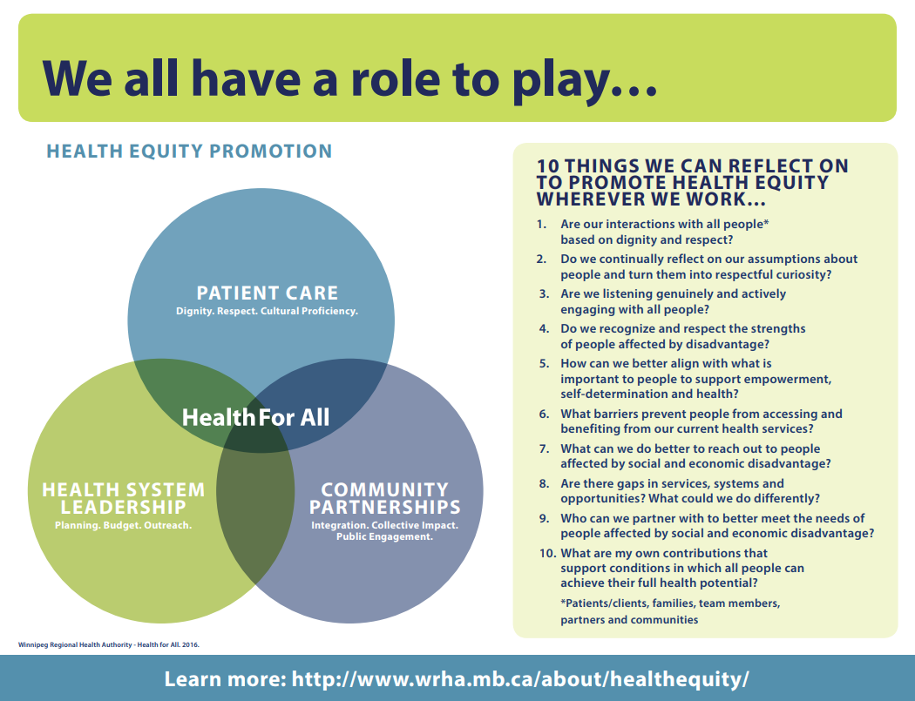
Notes:
This exercise is adapted from the Winnipeg Regional Health Authority:
http://www.wrha.mb.ca/about/healthequity/files/WhatCanIDo.pdf
http://www.wrha.mb.ca/about/healthequity/files/RoleToPlay.pdf
Provide participants with print versions of the two documents in the links above.
In small groups or all together, consider the feasibility for EPHPs to use these suggested actions. What could be implemented now? What might be the anticipated outcomes? Which actions have organizational barriers and how could they be overcome?
Consider using a “dignity” question when interacting with clients who might face barriers e.g., “What do I need to know about you as a person to work with you as effectively as possible?”
Listen genuinely and provide explanations that are easy to understand considering literacy, language, comprehension, attention, priorities, etc.
Factor social and economic factors into risk assessment and response plan (cost, accessibility, acceptability, feasibility, barriers).
Collect and use local population health data and assessments to understand your community and clients as members.
Build ongoing relationship of trust for continuity of service.
Refer clients to supportive community programs and services. Use bc211 where appropriate.
Provide client advocacy such as filling forms, letters for better housing, forms for work, increased funding, support program eligibility.
Take notes and discuss service gaps and unsolved or recurring problems with your supervisors.

Slide 20
Summary and next steps
Notes:
Optional:
Summarize the main points you wish to highlight for the group.

Slide 21

This Photo by Unknown Author is licensed under CC BY-NC
Notes:
Questions

Slide 22



Contact & Acknowledgements
Through an Equity Lens
BC Centre for Disease Control
pph@phsa.ca
http://www.bccdc.ca/health-professionals/professional-resources/health-equity-environmental-health
Notes:
Remind everyone to fill out evaluation forms.

