Slide 1
Introduction to health equity
Presenter
Date
Location

Slide 2
Objectives
Introduce the concepts of health equity and the social determinants of health (SDH)
Illustrate ways that they can intersect with EPHPs’ practice
Consider how EPHPs might respond to health equity issues
Notes:
NOTES:
Note that the relationship between health equity and SDH will also be clarified in the session (see slide 8).
The third objective will not be fully addressed unless the optional interactive exercise is included.

Slide 3
BCCDC Through an Equity Lens
Project goals
Increase knowledge of how health inequities relate to EH and EH practice
Assess workforce capacity (EPHPs)
Identify needs and gaps for supporting EPHPs
Develop resources for EH practitioners
Help practitioners help vulnerable populations
Identify policy options
Notes:
This knowledge about health equity and environmental public health practice was generated through a BC Centre for Disease Control project called Through an Equity Lens.
That project aimed to identify how barriers arise in environmental public health practice, and to develop some support tools for EPHPs.
NOTES:
This is provided as background info only, to show the origins of this work and resulting information.

Slide 4
Agenda
Introduction
Introduction to health equity and the social determinants of health
Equity in environmental public health practice
Scenario exercise
Conclusion and next steps
Notes:
NOTES:
The scenario exercise is optional, pending time availability. It is very useful to help frontline practitioners make the connection between health equity and their day to day practice, so facilitators are encouraged t

Slide 5
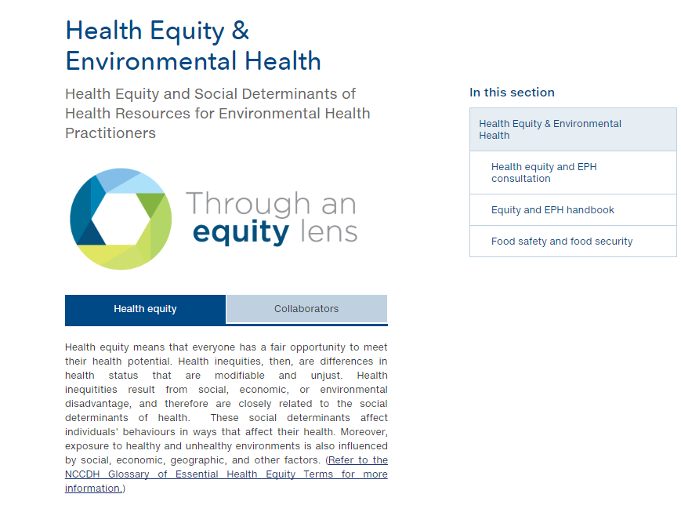
http://www.bccdc.ca/health-professionals/professional-resources/health-equity-environmental-health
Notes:
Why are we talking about health equity in relation to environmental public health?
British Columbia’s Guiding Framework for Public Health outlined a role for public health in affecting the SDOH and reducing inequities, in part by addressing barriers to access for services.
It also identified health equity as cross-cutting issue for public health services in BC.
Those goals led to a BCCDC project to identify how barriers arise in environmental public health practice, and to develop some support tools for EPHPs.
BCCDC worked closely with the National Collaborating Centres for Determinants of Health and Environmental Health to co-develop some resources and engage in knowledge development and translation.
NOTES:
Image is from the main website home to health equity resources for EPHPs, on the BCCDC website. The resources used in this presentation can all be downloaded from that site.

Slide 6





Why health equity and EPHPs?
Notes:
WHY TALK ABOUT HEALTH EQUITY?
Reducing health inequities is a priority for public health practice at national and provincial levels.
Equity is highlighted as an overarching issue in frameworks, health status reports, and policy documents. But, the role for EPHPs is not always clear.
As public health professionals, EPHPs have a role to play in supporting health equity.
EPHPs witness many social factors that influence health equity.
How EPHPs respond or interact with operators and clients can also exacerbate or mediate existing health inequities, so it is important that EPHPs are aware of health equity issues and the social determinants of health that lead to inequities…..
_________________________________
An equity lens is strategic:
Supports regional public health organization (e.g., health authority, health unit, public health department) or health unit goals and commitments for cultural safety, diversity, and inclusion.
Provincial health vision statements, protocols, guidelines, etc increasingly take a bigger picture approach to public health with a focus on upstream prevention – and some explicitly mention health equity (e.g., ON, NS).
Fits with Accreditation Canada goals for public health institutions.
Stated goal from Dr Theresa Tam, Canada’s Chief Public Health Officer, January 2018:
Over the course of my mandate, I will champion the reduction of health disparities in key populations in Canada. All Canadians deserve a chance to achieve optimal health so that they can fully participate in, and contribute to, society. A healthy Canada requires us to level the playing field, so that the poorest and most marginalized among us have a chance to lead healthy lives, both physically and mentally.
In so doing, I am committed to working with all of our partners, to support science and research to provide the best evidence to inform our actions, and to engage with Canadians, especially those with lived experience. I will continue to work collaboratively with ‎the Public Health Network Council, the Council of Chief Medical Officers of Health, and with other federal ministries who, through their mandates and programming, can help effect change in the inequity landscape.

Slide 7
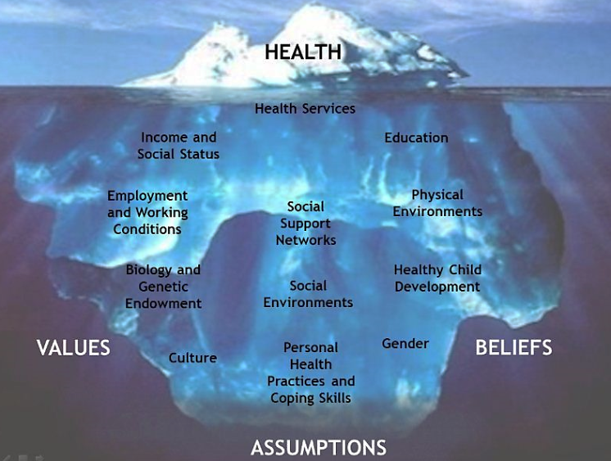
Social determinants of health (SDH)
Interrelated social, political and economic factors that create
the conditions in which people live, learn, work and play
Glossary of Essential Health Equity Terms: http://nccdh.ca/resources/glossary/
Notes:
The social determinants of health (SDH) are the interrelated social, political and economic factors that create the conditions in which people live, learn, work and play.
Some examples are food security, housing, education, and income.
The SDH intersect and cause these conditions to shift and change over time and across the life span, which impacts the health of individuals, groups and communities in different ways.
Social determinants impact people’s life course well into the future and future generations, e.g., a child growing up in an unhealthy home may have health impacts later in life.
See the NCCDH Glossary for more detailed definitions.
NOTES: The next slide shows how the SDH relate to health equity.

Slide 8
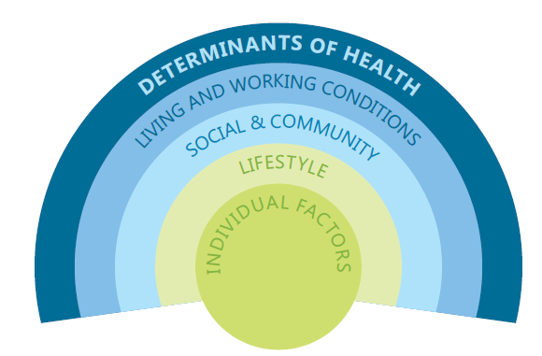
Social determinants of health (SDH)
Inequities in SDH….
May be associated with undue exposure to unhealthy environments.
Affect individuals’ actions in ways that affect their exposure and health status.
Can increase vulnerability to environmental factors that negatively impact health and wellbeing.
May be associated with decreased access to services that could address the impacts of unhealthy environmental exposures.
http://nccdh.ca/resources/glossary/
Notes:
Patterns in the distribution of the SDH create inequities in the health of populations and communities.
This can create barriers to compliance with public health regulations, as well as impact people’s ability to live healthy lifestyles.
Therefore, it is important to address SDH if we want to achieve health equity – health for all people.
NOTES:
Discuss how SDH can create health inequities. Facilitator may wish to have brief check-in with participants to ensure understanding of these concepts.

Slide 9
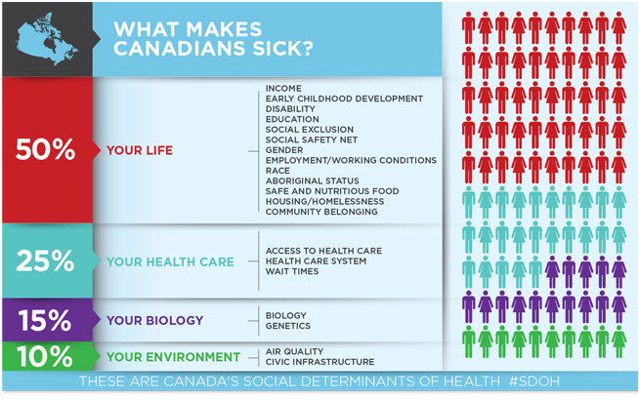
SDH impact:
Physical environment
Access to services
Health-related behaviours
www.cma.ca
Notes:
SDH have a huge impact on people’s health – much more than environment.
--CLICK ONCE FOR CIRCLE TO APPEAR—
As we will discover today, however, there are overlaps between social conditions and environments where EPHPs can have an impact.
NOTES:
This graphic shows the relative importance of SDH and physical environment. Consider the impact that attention to SDH within an environmental health context could strengthen the impact of your work.

Slide 10
Health
Income
Education
Food insecurity
Housing
Social exclusion
Aboriginal status
Gender
Race
Disability
Working conditions
Health services
Child development
Notes:
Many of the barriers that were discussed by EPHPs in focus groups closely link to the social determinants of health.
For example…..
--CLICK FOR ANIMATIED BUBBLES TO APPEAR--
Income – ability to pay for maintenance or upgrades
Education – literacy and comprehension of regulations and requirements
Working conditions – working when sick because of income or job security issues
Food insecurity – the use of meat and foods from non-approved sources in aboriginal or remote communities with limited access to alternatives
Housing – issues such as bed bugs or mould often relate to social determinants of health
Race – cultural differences were frequently cited barrier in this study
Aboriginal status – food security and remote communities are common issues
Health services – the EPHP/inspection process is part of the public health service and should be equitable in terms of support and protecting the public from health hazards
(based on Mikkonen and Raphael 2010 – Social determinants of health: The Canadian facts)

Slide 11
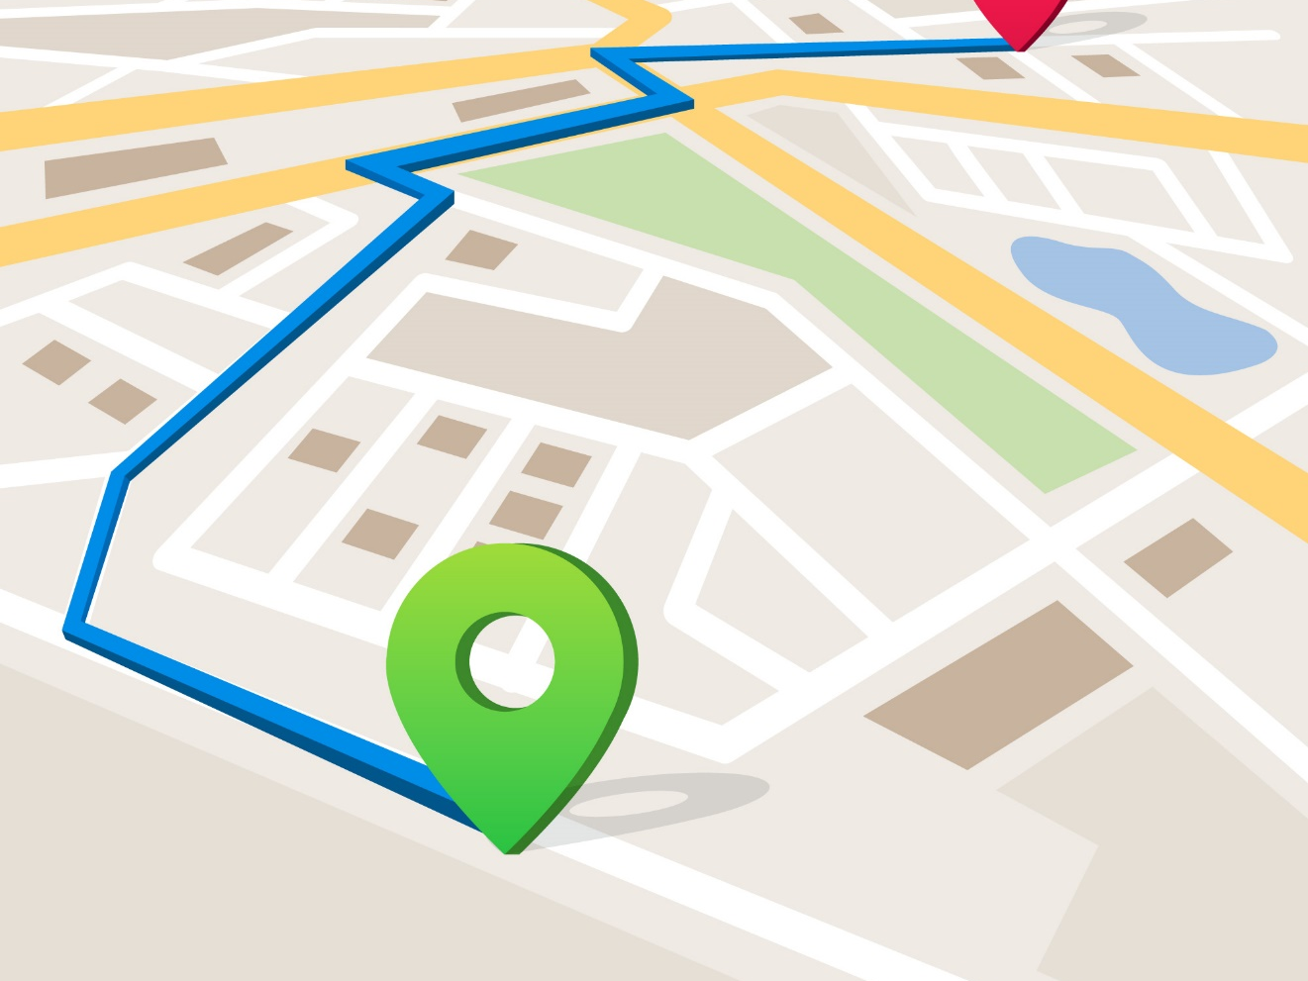
“If we identify health as our destination, then SDH is the roadmap to that destination.”
Image: freepik
- Ryan Meili @ St Francis Xavier University, hosted by NCCDH, March 2, 2016
Notes:
SDH do not exist in isolation. Addressing them is not an endpoint – e.g., “there, we have addressed food security – all done!”
It is a map that we need to keep navigating to get to health.
(Slide adapted from NCCDH.)
NOTES:
This describes the relationship between SDH, health equity, and environmental public health work. It highlights the value of overlaying a health equity lens (i.e., attention to SDH) onto EPH work. It also shows that SDH are everyone’s business – not just for social services to address.

Slide 12
Health equity
When everyone has a fair opportunity
to reach their full health potential
without disadvantages caused by their
social, economic, or environmental circumstances.
Source: NCCDH
Notes:
What do we mean by HEALTH EQUITY?
(In this definition, “everyone” includes individuals, groups, and communities.)

Slide 13
Equity doesn’t mean “all the same”
Health inequity
Health inequality
Differences in health associated with social disadvantages that are modifiable, and considered unfair
Measurable differences in health between individuals, groups or communities
(Also health disparities)
Inequities related to environments
are modifiable.
Source: NCCDH
Notes:
Equity is not the same thing as equality.
Health inequities are systematic, avoidable, and unfair. They relate to differences in opportunity to be healthy.
--CLICK ONCE FOR SECOND COLUMN TO APPEAR—
Health inequalities are not avoidable. They include health differences related to sex, genetic predisposition, age, etc.
--CLICK FOR CLOSING STATEMENT TO APPEAR--

Slide 14
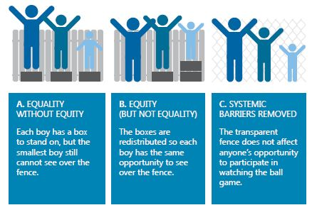
EPH practitioners can promote health by supporting individuals and removing barriers
Notes:
Equity vs Equality
EPH practitioners can promote health by supporting individuals and by removing barriers.
NOTES:
The text in the boxes below each graphic element describes how the three children represent equity and equality, and how the boxes and fence represent a public health response.

Slide 15
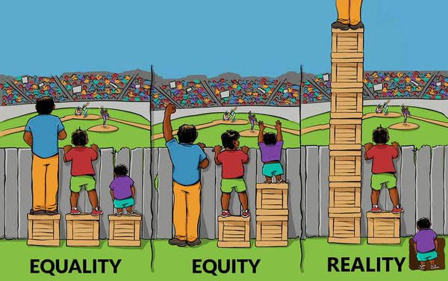
Notes:
Unfortunately, the reality is that the privileged often receive the most supports and benefits in society while the people who face more barriers have lower access to supports.
This serves to increase the gap between groups. This wide gap is associated with poorer population health overall.
EQUALITY: We can see that treating everyone the same benefits some people who don’t need help, while others are still disadvantaged. The shorted child in this picture still can’t see, even with a box to stand on.
EQUITY: As we saw in the previous slide, providing the appropriate amount of support, according to need or circumstances, can level the playing field. In the middle picture, each child has the same view of the ball game.
REALITY: This is somewhat tongue-in-cheek, but it’s important to recognize that, often, the privileged in society have access to the most support or services. Vulnerable populations are often further disadvantaged by lack of access to services or other barriers. This is shown here by the tallest child standing on a stack of boxes, while the shortest child is stuck down in a hole that he can’t see out of.

Slide 16
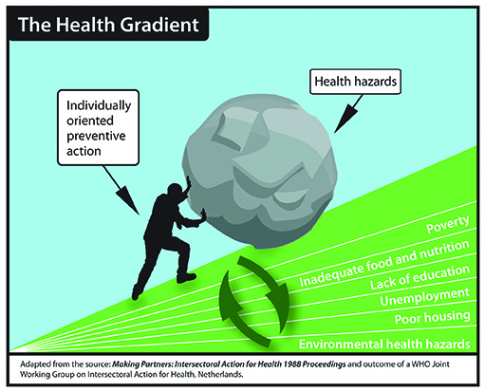
Notes:
It is important to narrow the equity gap. People with barriers also face more health hazards and unhealthy environments, so it all adds up.
People who lack positive social determinants face an uphill battle to get and stay healthy.
As public health practitioners, we have a role to help individuals in that uphill battle.
Action must focus on the big picture and aim to make healthy environments accessible to all people. Remove the injustices and minimize the difference between privileged and not.
Also remember that it’s not just about “fixing” the poor or underserved. We all need to change to level the playing field.
EH can show leadership here by looking beyond quick fixes to understand the underlying issues that created the problems and work to improve the system.
NOTES:
This image can take some time to digest. Ensure facilitator has a clear understanding before including it in the presentation. The main take-away for this presentation is that the more SDH-related barriers people face, the harder it is for them to do all/other things that can improve or maintain their health. (And the harder it is to follow public health guidelines and regulations.) With each SDH challenge, the hill gets steeper and the health hazards increase, making things doubly harder for the individual.

Slide 17

Making The Connections: Our City, Our Society, Our Health
Wellesley Institute | https://youtu.be/q-3mUiGi6bA
Notes:
This 2012 video from the Wellesley Institute shows how health is about more than having access to doctors, drugs and hospitals.
It illustrates ways that our health is shaped by a complex set of interconnected and dynamic social factors: the circumstances in which people live, grow, work, and age.
https://www.youtube.com/watch?v=q-3mUiGi6bA&feature=youtu.be

Slide 18
How does health equity fit with EPH practice?
Notes:
This section will focus in more detail on how health equity relates to environmental health, and why it is an important issue for EPHPs.

Slide 19

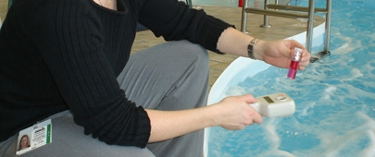
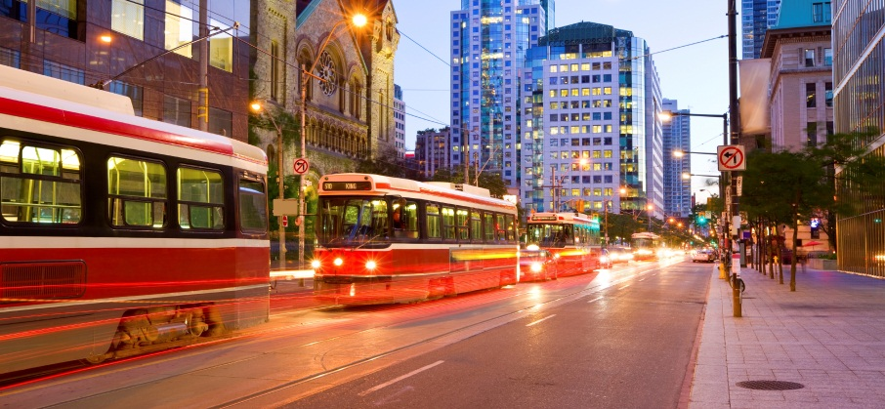
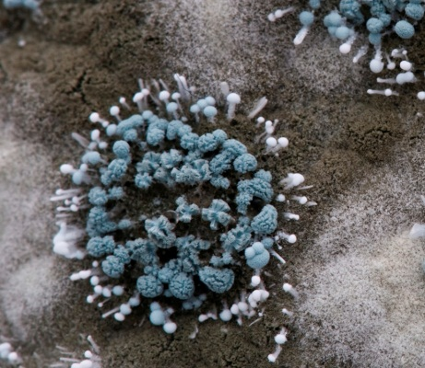

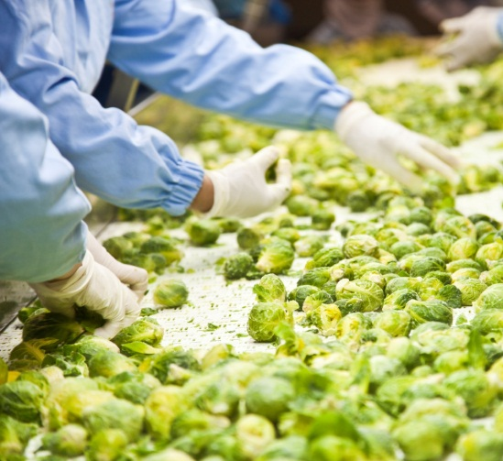

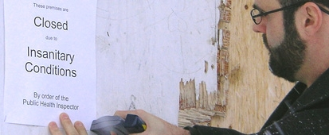
Health equity and EPH practice
Inequities create barriers to compliance
May or may not be recognized by EPHP
EPHP response may help mitigate inequities
EPHP response could exacerbate inequities
Notes:
EPHPs work includes inspection, enforcement, and training activities in a range of settings:
e.g., food premises inspection, drinking water systems, recreational water, personal services, built environments, CD control, etc.
--CLICK ONCE FOR ANIMATION TEXT BOX TO APPEAR--
As we have shown, patterns in the distribution of the SDH create inequities in the health of populations and communities, which in turn creates barriers for people.
The specific role for environmental public health is still being clarified, but it is clear that issues related to the SDH arise in practice and that how EPHPs respond matters.

Slide 20

http://www.bccdc.ca/resource-gallery/Documents/Educational%20Materials/EH/BCCDC_primer_1.pdf
Notes:
Much of the information to follow is included in a series of three Primers on Health Equity and EPH available on the BCCDC website.
These Primers are a good introduction for people new to this area or who are unsure how it relates to practice. The information should be useful to frontline staff as well as managers and senior leadership.
Five things to know about equity in EPH, highlights the ways that equity intersects with EPH practice and illustrates how an equity lens might be used.
This is the first of three primers.
The contents of this Primer are reflected in the next two videos.

Slide 21

Equity 101-1: Introduction to health equity for EPH professionals
BCCDC | https://youtu.be/WDgoZXoUKAo
Notes:
This 4½-minute video from BCCDC introduces the concept of health equity and how it relates to EPHP practice.
https://youtu.be/WDgoZXoUKAo

Slide 22
Equity 101-2: Introduction to the social determinants of health for EPH professionals
BCCDC | https://youtu.be/TDeThM6FQv8
Notes:
This BCCDC video introduces the social determinants of health, with examples of how they impact practice.
https://www.youtube.com/watch?v=TDeThM6FQv8&feature=youtu.be

Slide 23
Equity and EPH practice
SES
Food premises
SDWS
Culture & Language
Food premises
PSEs
Literacy & Education
SDWS
Food premises
PSEs
Psycho-social
Geography
Housing
Food premises
SDWS
Food premises
Built environ.
Housing
Built environ.
Notes:
This slide shows the social determinants that frequently arise in different settings of environmental public health practice.
Socioeconomic status
Financial restrictions/cash flow - ability to pay for maintenance or upgrades
Employee finances in job security - working when sick because of income or job security issues
Cultural differences
Expectations of EPHPs/operator relationship
Immigrants in new industry (food)
Language/Literacy - comprehension of regulations and requirements
Limited English language skills
Low literacy/computer literacy
Stress
Distraction
Intensify other barriers
Housing issues such as bed bugs or mould often relate to social determinants of health
Geography
Access to equipment, parts, expertise
Food security in remote communities - use of meat and foods from non-approved sources in aboriginal or remote communities with limited access to alternatives

Slide 24
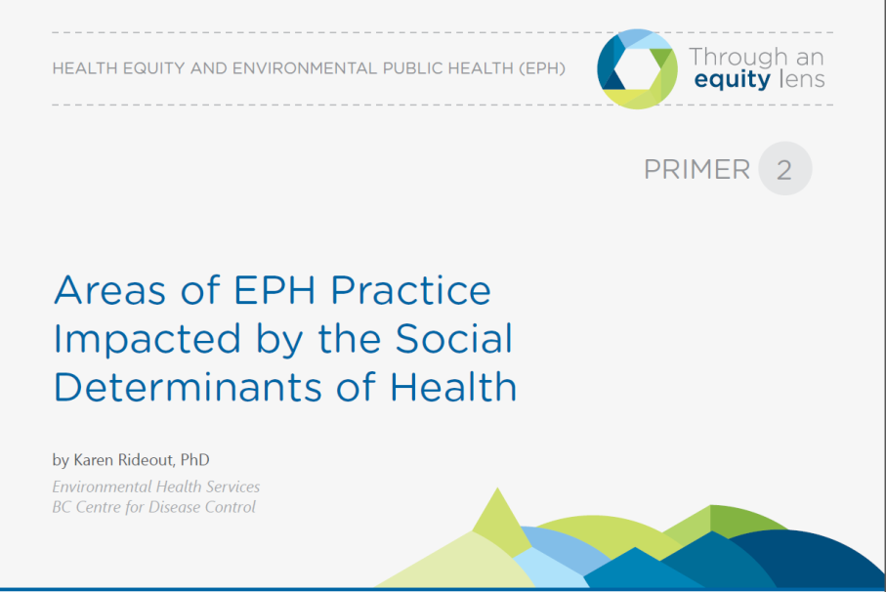
http://www.bccdc.ca/resource-gallery/Documents/Educational%20Materials/EH/BCCDC_primer_2.pdf
Notes:
2. Areas of EPH Practice Impacted by the Social Determinants of Health illustrates how equity issues impact different areas of EPH practice.
This is the second of three primers.

Slide 25
Equity 101-3: How social determinants of health impact EPH practice settings
BCCDC | https://youtu.be/gCpp9r8PAAc
Notes:
This 7-minute video from BCCDC shows how social determinants arise across different EPHP practice settings.
https://youtu.be/gCpp9r8PAAc

Slide 26
Practice settings affected by SDH
Food premises | Geography | Culture | SES | Language | Education | Literacy
Drinking water Sewage treatment | Geography | SES | Education | Literacy
Housing | Mental health | SES | Vulnerable groups
PSEs | Language
Built environment | Vulnerable groups | SES
Notes:
SDH can affect almost any area of EPH practice, potentially creating barriers and health inequities.
The next slides will show some specific examples from different practice settings. This will not be an exhaustive list, but typical of stories heard from EPHPs during focus groups with BCCDC, NCCEH, and NCCDH.
These slides indicate an example of commonly reported barriers witnessed by EPHPs, along with some promising practices in terms of how to respond.
26

Slide 27

Food premises: Geography
If they were cooking with meat that they shouldn’t be cooking with … because they caught it, and in a lot of those communities…they couldn’t get any other kind of protein.
So I would make it the safest possible for them, instead of saying, no, you can’t have it at all.
Photo: FairbanksMike
Notes:
Barriers: Food security & access to cultural foods
Game meat or wild fish may not come from approved food source but important for food security if access to food is limited or if that what people can afford. Also important for many cultural traditions.
Strategies:
Discretionary interpretation of guidelines to focus on critical risks.
Educate people to make the food the safest it can be and decrease risk in that context.
--CLICK ONCE FOR QUOTE TO APPEAR--
ADDITIONAL QUOTE:
… but if that’s all they have… do it in the best way to reduce their risk.

Slide 28
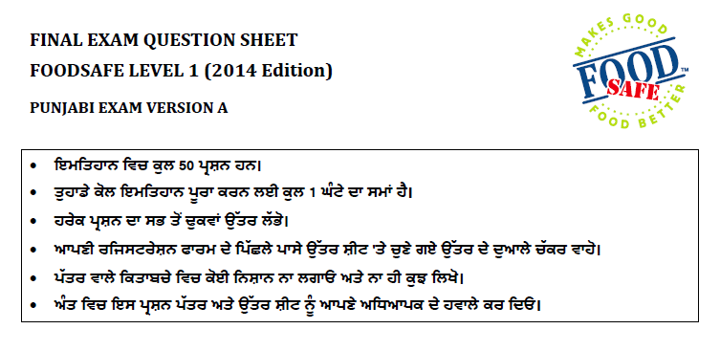
Food premises: Education & language
Some language might make sense to chefs who have gone to culinary school, but for the ones who have maybe grade 10 or grade 9 or grade 8 level education,
it can be really challenging.
Notes:
Barriers: Education and language can create a double barrier, particularly for certification tests and documentation of food safety plans.
--CLICK ONCE FOR QUOTE TO APPEAR--
Strategies:
Walking through things and explaining details
ADDITIONAL QUOTE:
One thing is the requirement for food safety plans – a written document. Often the information that we give to them is WAY too overloaded - it just looks confusing.
So, sitting down at the beginning and even walking through a recipe with the person really helps. So, it’s just spending the time.
We’re meant to be educators - that’s number one.
(Image shows a FoodSafe exam preamble translated to Punjabi.

Slide 29
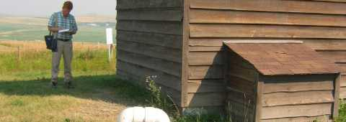
Drinking water: Geography
Even though the operator did everything they could, it’s still past 30 hours.
Notes:
Barriers: Inability to meet testing requirements and sampling schedules due to remote locations - slow transport, weather, ferry and float/bush plane schedules.
May need boil water advisories.
Also difficulty attending professional development, because a 1-day course might require 5 days travel.
--CLICK ONCE FOR QUOTE TO APPEAR--
Strategies:
Give verbal approvals.
Search for other testing options.
Intervene so lab will still do analysis with late samples.
Issue: The regulations are not fitting the context in many of these locations.
ADDITIONAL QUOTE:
I’ve crunched the data for an operator more than once, just because I know they travel from four or five hours out of town [to send the sample]. I’ll just change the date just so the lab will sample it. You know, and you just take it as a presence/absence or whatever, right?

Slide 30

Drinking water: Literacy
Maybe they’ve done it so long they KIND of know what to do, but if you write a report that’s somewhat technical they don’t necessarily know how to follow that and read that.
Notes:
Barriers: Many people do not have specific or technical training, especially people running very small water systems.
Identifying literacy barrier is often difficult – people may know what to do but be unable to write it down.
--CLICK ONCE FOR QUOTE TO APPEAR--
Strategies:
Often work one-on-one and walk through written materials verbally.

Slide 31
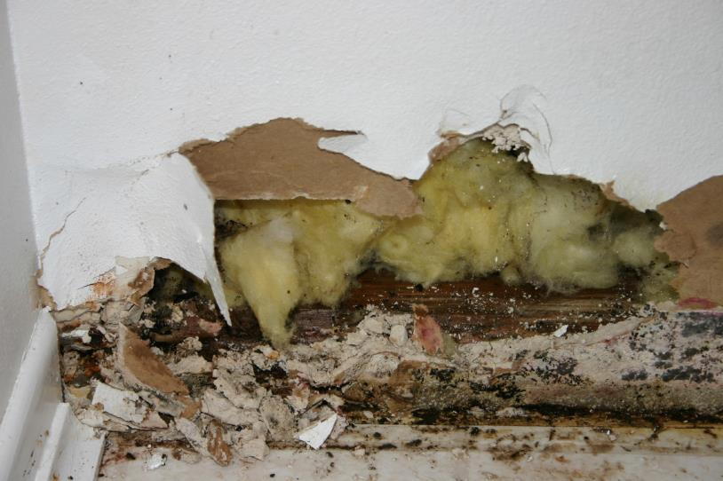
Housing: SES & Vulnerability
If we followed the rules and they followed the rules, we couldn’t get this done. But because we’ve built these relationships, [we help each other].
Sometimes it’s under the radar because I’m not sure our managers would be that happy ...
But in the long term, you get the cooperation that’s going to move you forward.
I mean, it’s not a compliance issue, but in order to get these vulnerable people help, the health inspectors also need to know who do they go to?
Housing is an interesting situation, because I think it’s pretty clear that it’s not us.
We all get sucked into playing the game because we’re compassionate people and we want to help.
I feel supported in doing that on an occasional basis…
Notes:
Barriers: Vulnerable people (single mom, elderly, etc.) complains about mould, bed bugs, or other repairs.
EPHP may not have authority, but sees problem as first line of contact. Note that Alberta has a Housing Regulation and EPHPs do have authority and a mandate to intervene in housing to much greater extent than in other provinces and territories.
Strategies:
Try to refer or intervene where they can, often outside their formal role. May or may not be supported by management so sometimes do this under the radar.
--CLICK ONCE FOR NEXT QUOTE TO APPEAR– FEEL FREE TO OMIT ANY OF THE QUOTES THAT ARE NOT RELEVANT TO LOCAL CONTEXT
The quotes presented here are from EPHPs working in regions that do not have a clear mandate for responding to housing issues – they may not be relevant in regions where housing is explicitly included in the EPH mandate.
Issue: There is a gap in authority here, unless there is another agency that is responsible for public health in housing situations.
ADDITIONAL QUOTE:
So, unless the province decides that they’re going to make it our mandate, it keeps falling off the plate of everybody.

Slide 32
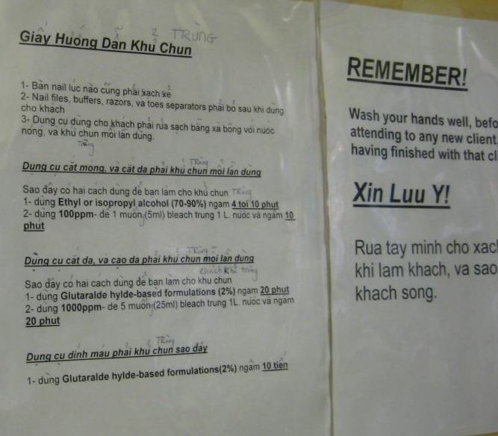
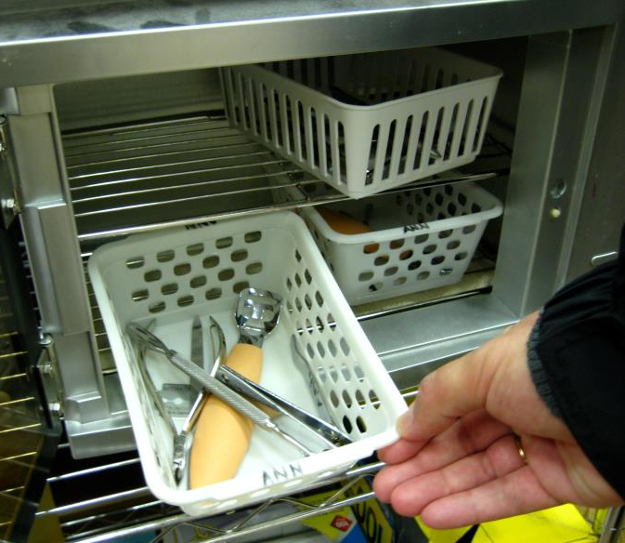
PSEs: Language
Notes:
Barriers: Language is a common issue in PSEs.
Challenge is in communicating how and why to do things – e.g., reusing single use items, acceptable forms of sterilization, sanitizing procedures, etc.

Slide 33
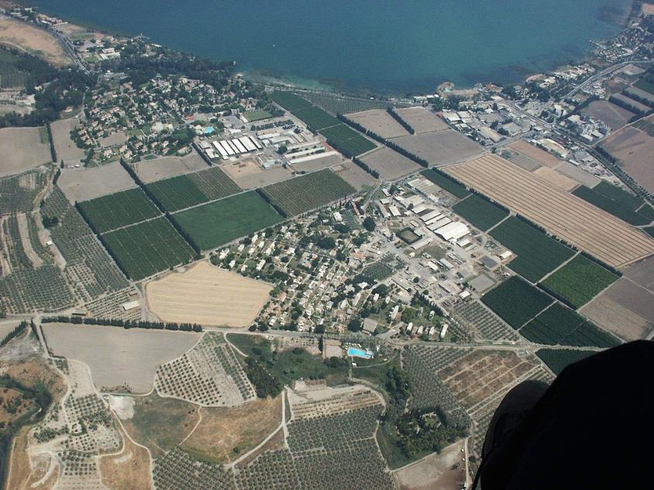
Built environment: Geography
We’re starting to get Mental Health to come on board. They don’t have the resources. But for a big development that could be impacted because of addiction and maybe they’re going to put a …liquor house on a corner of downtown but there’s a residential neighbourhood around it.
We can start putting those kind of comments and official community plan comments to Mental Health, and they’re starting to get the idea that they could make comments to do with how that could affect the social structure of that particular neighbourhood, where we never had that before.
Notes:
Healthy built environment (HBE) is a new area of practice with potential equity benefits:
HBE programs exist in all BC health authorities. EPHPs are involved in development permits as well as more involved work with local governments to inform community planning decisions.
HBE teams are gaining specialized knowledge in what to look for.
HBE teams are collaborating across sectors – refer to nutrition re applications for agricultural land rezoning, mental health re neighbourhoods.
--CLICK ONCE FOR QUOTE TO APPEAR--
This is a new “voice” for EPHPs on many issues that relate to health equity and environmental public health.

Slide 34
?
How have the
social determinants of health
or health equity issues
come up in your own practice?
Notes:
Ask for examples from participants – in plenary. Have a discussion with the groups (use small groups if seems more appropriate).

Slide 35

Scenario review
Notes:
Use this slide for a collective exercise that gets people out of their seats.
Participants independently review short scenarios posted around the room. Scenarios are designed to illustrate the kinds of health equity issues that arise in environmental public health, as well as to encourage self-reflection and provoke new ways of thinking about these issues. [NOTE: Scenarios are available in the Ready-Made Session folder where you downloaded this PPT presentation.]
Participants will be asked to walk around the room and read the scenarios. They are presented as examples of how EPH and health equity have come together to give a sense of some of what we have learned about promising practices and ways that EPH staff can be involved with the social determinants of health and health equity.
Consider these scenarios and your own individual reflections as you enter the rest of the session.
The next slide includes a list of discussion questions to use after people review the scenarios.

Slide 36
Health equity scenarios
What is the main issue raised in this scenario (i.e. the obvious problem)?
What underlying issues might be present
(i.e. the not-so-obvious problem)?
How would you typically approach the situation?
Can you think of alternative approaches?
How might the outcomes differ between the two approaches? What are the arguments for and against using each approach?
Notes:
Use this slide to guide group discussion about the health equity scenario exercise (walkabout or small group discussion format).

Slide 37
Summary and next steps
Notes:
Optional:
Summarize the main points you wish to highlight for the group.

Slide 38

This Photo by Unknown Author is licensed under CC BY-NC
Notes:
Questions

Slide 39



Contact & Acknowledgements
Through an Equity Lens
BC Centre for Disease Control
pph@phsa.ca
http://www.bccdc.ca/health-professionals/professional-resources/health-equity-environmental-health
Notes:
Remind everyone to fill out evaluation forms.

