Slide 1
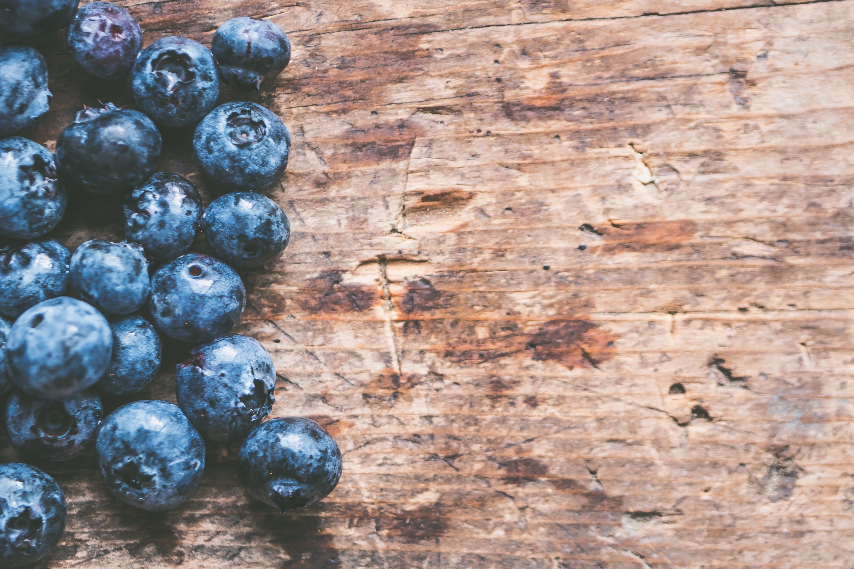
Introduction
10 WEEK GROUP

Slide 2
OUR NUTRITION philosophy
All foods fit
Aim for a regular eating schedule
Eat a variety and balance of foods at each meal and snack
Small changes are best

Slide 3
Group Rules
CONFIDENTIALITY
TURN PHONES TO SILENT
RESPECT MEMBERS OF THE GROUP
TRY TO BE ON TIME

Slide 4
GROUP STRUCTURE: 2 hours
30 to 60 minutes nutrition education and activities
60 to 90 minutes cooking skills class

Slide 5
KITCHEN SAFETY
Wash your hands
Before you start
After touching raw meat/poultry
Tie up long hair, secure loose clothing
No running/throwing/yelling
Careful with sharp/hot items
Knives, stove, oven
Keep our workspace clean
If it is dirty, wash it
Avoid cross contamination (meat)
Let us know what you are comfortable with
Try new things and foods

Slide 6
SMART GOALS
S
SPECIFIC
How are you going to achieve your goal?
M
MEANINGFUL
Is this goal meaningful to you?
A
ACTION ORIENTED
What steps will you take to achieve this?
R
REALISTIC
Is this goal something that you will be able to achieve?
T
TIMELY
By when do you want to achieve this goal?

Slide 7
EXAMPLE
M
Eat more vegetables
I will eat more vegetables at dinner
I will eat ½ my plate of vegetables at dinner
I will eat ½ my plate of vegetables at dinner, 3 days this week
I will eat ½ my plate of vegetables at dinner, 3 days this week, and every week I will increase the number of days until I eat vegetables at lunch every day
S
M
S
M
A
S
M
A
R
S
M
A
R
T

Slide 8
HOW TO GET THE MOST OUT OF THE NEXT 10 WEEKS:

Slide 9
Try some goals at home!
Involve your family!
Even 1 change is great!

Slide 10
Thank you to our sponsor
Canada’s Children’s Hospital Foundations (CCHF) is grateful for Sun Life Financial’s $2 million commitment to support the creation of Meant2Prevent: A type 2 diabetes prevention initiative for children and youth presented by Sun Life. As part of Sun Life Financials’ Team Up Against Diabetes platform, this partnership allows the children’s hospital network of experts to positively influence children and youth to live healthier lives through awareness and education. Thank you Sun Life Financial for your dedication to building sustainable, healthier communities and families by helping to prevent type 2 diabetes.

Slide 11
This project is part of
www.Meant2Prevent.ca
www.Meant2PreventKitchen.ca

